Slide 1

Title: Setting Up Python

Slide 2

Install Python
Important: During installation, check the box to "Add Python to PATH." This allows you to run Python from the command prompt or terminal

Slide 3

Install an IDE

Slide 4
Recommended IDEs
PyCharm: Advanced IDE with powerful features for professional development
VSCode: Lightweight, highly customizable editor with support for multiple extensions
Jupyter Notebook: Ideal for data science, supports interactive code execution

Slide 5
Verify Installation
Open a terminal and type python --version to confirm Python is installed
Ensure pip is also installed by typing pip --version

Slide 6
Install Essential Packages
Command: pip install numpy pandas matplotlib

Slide 7
Title: Basic Python Commands

Slide 8
Print Statement
Syntax: print

Slide 9
Variables
Assigning values: Use = to assign a value to a variable
Example: x = 10, name = "Alice"
Print variable: Use print to display the value of x

Slide 10
Basic Arithmetic
Multiplication: a * b
Division: a / b

Slide 11
Comments
Single-line comment: # This is a comment
Multi-line comment: Use triple quotes to span comments over multiple lines

Slide 12

Definition

Slide 13
Insert
Add an item to the end: my_list.append
Insert at a specific position: my_list.insert

Slide 14
Remove
Remove an item by value: my_list.remove

Slide 15
Additional Operations
Length of list: len
Sorting a list: my_list.sort

Slide 16
Definition
A tuple is an ordered, immutable collection of items
Tuples are often used for data that shouldn't change throughout the program

Slide 17
Accessing Elements
Access by index: my_tuple
Slicing: my_tuple

Slide 18
Additional Features

Slide 19
Definition
A dictionary is an unordered collection of key-value pairs

Slide 20

Accessing Values

Slide 21
Removing Items
Remove by key: my_dict.pop

Slide 22

Additional Operations
Iterate through keys: for key in my_dict: print
Iterate through key-value pairs: for key, value in my_dict.items : print
Check if a key exists: 'name' in my_dict

Slide 23
Definition
Example: my_set =

Slide 24
Add and Remove
Add an item: my_set.add
Remove an item: my_set.remove

Slide 25
Set Operations
Union: set1.union
Intersection: set1.intersection

Slide 26
Additional Features
Difference: set1.difference
Subset: set1.issubset

Slide 27
Advanced Data Types

Slide 28
Type Conversion
int converts a string '5' to an integer
str converts an integer 10 to a string '10'
float converts an integer 3 to a float 3

Slide 29
Additional Concepts
Type checking: Use type to check the type of a variable

Slide 30
Arithmetic Operators
Floor Division: //
Modulus: %
Exponentiation: **

Slide 31
Assignment Operators

Slide 32
Comparison Operators

Slide 33
Logical Operators

Slide 34
Membership Operators
Copy code if condition: # code to execute if condition is trueelse: # code to execute if condition is false

Slide 35
Example

Slide 36
Example

Slide 37
Nested If Statements
Syntax: You can nest multiple if-else blocks

Slide 38
Ternary Operator
Syntax: result = "Positive" if x > 0 else "Negative"

Slide 39
Example
range generates numbers from 0 to
Copy code while condition: # code to execute as long as condition is true

Slide 40
Example

Slide 41
Break and Continue
break: Exits the loop entirely
continue: Skips the rest of the loop's code for the current iteration and moves to the next iteration

Slide 42
Example

Slide 43
Nested Loops

Slide 44
Definition
A function is a block of reusable code that performs a specific task
Functions help to modularize your code, making it easier to manage and debug
Copy code def function_name : # code to execute return result

Slide 45
Example

Slide 46
Calling a Function

Slide 47
Default Parameters
Example: print ) will output "Hello, Guest" if no argument is provided

Slide 48
Keyword Arguments

Slide 49
Syntax

Slide 50
Variable-Length Arguments
Syntax: Use *args for positional arguments and **kwargs for keyword arguments

Slide 51
Lambda Functions
Syntax: lambda arguments: expression

Slide 52
Reading a File
Read line by line: line = file.readline

Slide 53
Introduction
Exception handling in Python allows you to handle errors gracefully and maintain the flow of your program even when something goes wrong

Slide 54
Common Exceptions
IndexError: When trying to access an index that is out of range
KeyError: When trying to access a dictionary with a key that doesn’t exist
ValueError: When a function receives an argument of the right type but inappropriate value

Slide 55
Example
Copy code

Slide 56
Finally Block
The finally block is executed no matter what, whether an exception occurs or not

Slide 57
Raising Exceptions
Title: Python OOP

Slide 58
Introduction
Object-Oriented Programming is a programming paradigm that uses objects and classes
It helps to organize code into reusable and modular components

Slide 59
Class and Object
Class: A blueprint for creating objects
Object: An instance of a class

Slide 60
Example

Slide 61
Encapsulation
Encapsulation is the practice of bundling data and methods that operate on the data into a single unit, or class

Slide 62
Private Attributes

Slide 63
Inheritance
Inheritance allows a class to inherit attributes and methods from another class

Slide 64
Polymorphism
Polymorphism allows different classes to be treated as instances of the same class through a common interface

Slide 65
Introduction
Modules: A module is a file containing Python code
Packages: A package is a collection of modules in directories that provide a hierarchy

Slide 66
Importing Modules

Slide 67
Example
Copy code from module_name import function_name

Slide 68
Example

Slide 69
Creating a Module
Copy code

Slide 70
Using Packages
Title: Python Libraries

Slide 71

Introduction
Python libraries are collections of modules and functions that help you perform various tasks without writing code from scratch

Slide 72
Popular Python Libraries
NumPy
Example: import numpy as np

Slide 73
Pandas
Example: import pandas as pd
Example: import matplotlib.pyplot as plt
Example: from sklearn.model_selection import train_test_split
Example: import tensorflow as tf
Example: from flask import Flask

Slide 74
Installing Libraries

Slide 75
Managing Dependencies

Slide 76
Introduction
Exception handling in Python allows you to handle errors gracefully and maintain the flow of your program even when something goes wrong

Slide 77
Common Exceptions
IndexError: When trying to access an index that is out of range
KeyError: When trying to access a dictionary with a key that doesn’t exist
ValueError: When a function receives an argument of the right type but inappropriate value

Slide 78
Example
Copy code

Slide 79
Finally Block
The finally block is executed no matter what, whether an exception occurs or not

Slide 80
Raising Exceptions
Title: Python OOP

Slide 81
Introduction
Object-Oriented Programming is a programming paradigm that uses objects and classes
It helps to organize code into reusable and modular components

Slide 82
Class and Object
Class: A blueprint for creating objects
Object: An instance of a class

Slide 83
Example

Slide 84
Encapsulation
Encapsulation is the practice of bundling data and methods that operate on the data into a single unit, or class

Slide 85

Private Attributes

Slide 86
Inheritance
Inheritance allows a class to inherit attributes and methods from another class

Slide 87
Polymorphism
Polymorphism allows different classes to be treated as instances of the same class through a common interface

Slide 88
Introduction
Modules: A module is a file containing Python code
Packages: A package is a collection of modules in directories that provide a hierarchy

Slide 89
Importing Modules

Slide 90
Example
Copy code from module_name import function_name

Slide 91
Example

Slide 92
Creating a Module
Copy code

Slide 93
Using Packages
Title: Python Libraries

Slide 94
Introduction
Python libraries are collections of modules and functions that help you perform various tasks without writing code from scratch

Slide 95
Popular Python Libraries
NumPy
Example: import numpy as np

Slide 96
Pandas
Example: import pandas as pd
Example: import matplotlib.pyplot as plt
Example: from sklearn.model_selection import train_test_split
Example: import tensorflow as tf
Example: from flask import Flask

Slide 97
Installing Libraries

Slide 98
Managing Dependencies

Slide 99
Introduction
GitHub is a web-based platform that uses Git for version control
It allows multiple developers to work on projects collaboratively

Slide 100
Repository
A repository is like a project folder on GitHub where your project’s files, including code, documentation, and issues, are stored

Slide 101

Clone a Repository
Copy code git clone https://github.com/username/repository.git

Slide 102
Check Status
git status

Slide 103
Commit Changes
Copy code git commit -m "commit message"

Slide 104
Push Changes

Slide 105
Branches
Branches allow you to work on different versions of a repository simultaneously

Slide 106
Creating a Branch

Slide 107
Merging Branches
Merging combines changes from one branch into another
bash

Slide 108
Pull Requests
A pull request lets you notify team members that you have completed a feature or bug fix and are ready for it to be reviewed and merged into the main branch

Slide 109
Introduction
Python offers numerous libraries that make data science tasks easier, including data manipulation, analysis, visualization, and machine learning

Slide 110
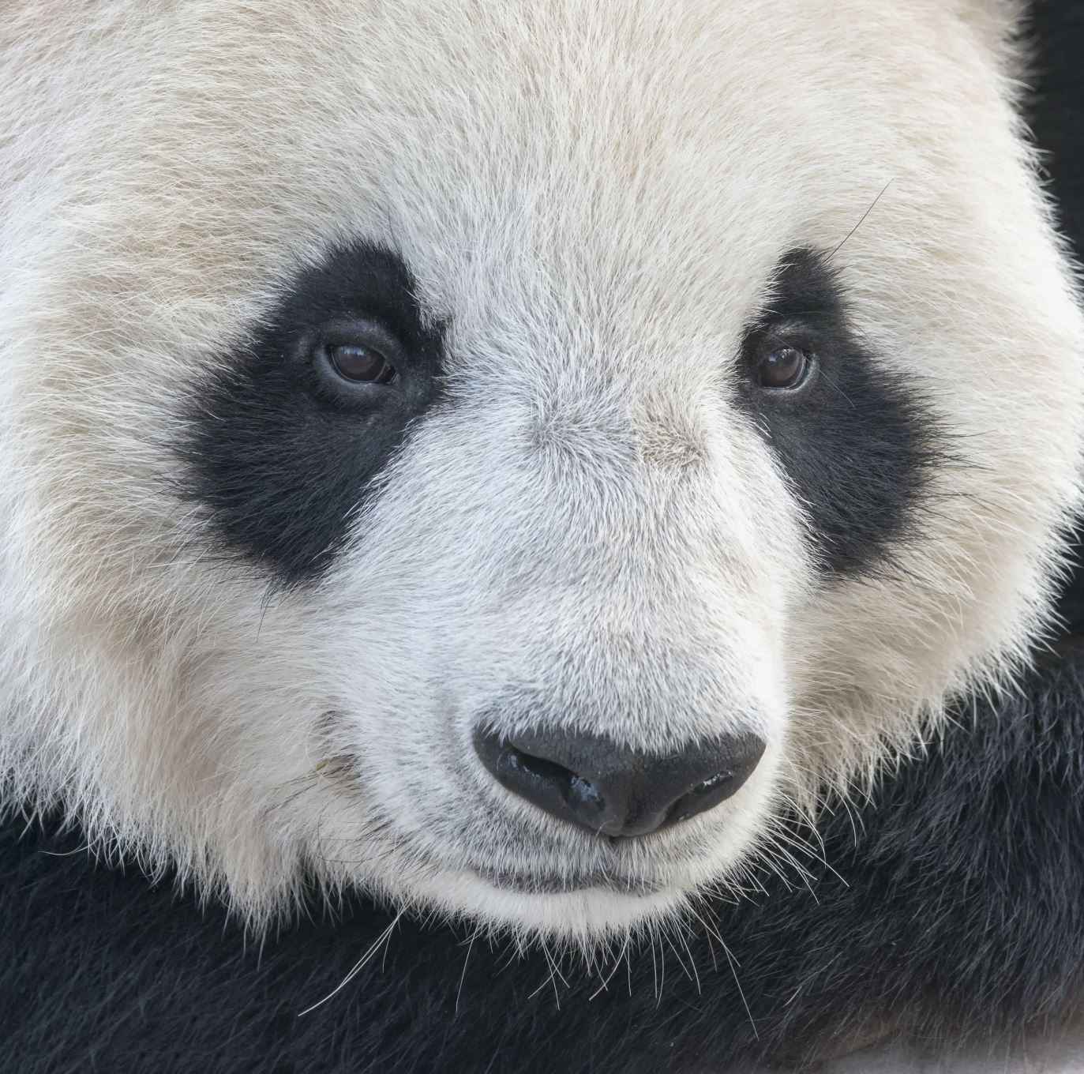
Pandas
Description: Pandas is used for data manipulation and analysis, especially with structured data

Slide 111
NumPy
Description: NumPy is used for numerical computations and supports large multi-dimensional arrays

Slide 112
Matplotlib & Seaborn
Description: These libraries are used for data visualization

Slide 113

Scikit-learn
Description: Scikit-learn is used for machine learning, providing simple and efficient tools for data mining and data analysis

Slide 114
TensorFlow & Keras
Description: These libraries are used for deep learning and neural networks

Slide 115
Introduction
Flask is a lightweight web framework written in Python
It is used to create web applications with minimal overhead

Slide 116
Example

Slide 117

Running the Flask Application
Visit http://127.0.0.1:5000/ in your web browser to see the output

Slide 118
Templates and Rendering HTML
Use HTML templates to render web pages
Copy code

Slide 119
Handling Forms
Title: Machine Learning

Slide 120

Introduction
Machine learning is a branch of artificial intelligence that involves training algorithms to learn from data and make predictions

Slide 121
Types of Machine Learning
Supervised Learning: The model is trained on labeled data
Example Algorithms: Linear Regression, Decision Trees, Support Vector Machines
Unsupervised Learning: The model is trained on unlabeled data to find patterns
Example Algorithms: K-means Clustering, Principal Component Analysis
Reinforcement Learning: The model learns by interacting with the environment and receiving feedback

Slide 122
Key Concepts
Training Data: The data on which the model is trained
Test Data: The data used to evaluate the model’s performance
Features: The input variables used to make predictions
Labels: The output variables that the model is trying to predict

Slide 123
Common Algorithms
Linear Regression: Used for predicting continuous values
K-Nearest Neighbors : Used for classification problems
Decision Trees: Used for both classification and regression tasks

Slide 124
Common Algorithms
Title: Deep Learning

Slide 125
Introduction
Deep learning is a subset of machine learning that uses neural networks with many layers to model complex patterns in data

Slide 126
Artificial Neural Networks
Structure: Composed of input layers, hidden layers, and output layers

Slide 127
Convolutional Neural Networks
Application: Used primarily for image recognition and classification

Slide 128
Recurrent Neural Networks
Application: Used for sequential data like time series or natural language processing

Slide 129
Training Deep Learning Models
Loss Function: The function that the model tries to minimize during training
Optimizer: Algorithm used to minimize the loss function
Epochs: Number of times the learning algorithm works through the entire training dataset

Slide 130
Example
Title: Assignments

Slide 131
Introduction
This section covers various assignments that were completed throughout the course
These assignments helped reinforce the concepts learned in Python programming, data science, machine learning, and web development

Slide 132
Assignment Topics
Python Basics: Writing scripts to solve basic problems, working with data types, loops, and functions
Data Science Assignments: Analyzing datasets, performing data cleaning, and generating visualizations
Machine Learning Models: Implementing and tuning models like linear regression, decision trees, and clustering
Web Development: Creating simple Flask applications, handling forms, and rendering templates

Slide 133
GitHub Repository

Slide 134
Introduction
This section highlights the key projects undertaken during the course, showcasing practical applications of Python, data science, and machine learning concepts

Slide 135
Project 1: Laptop Price Prediction
Description: A machine learning project to predict laptop prices based on features like processor, RAM, and storage
Tech Stack: Python, Scikit-learn, Pandas

Slide 136
Project 2: Email Classification Using Flask
Description: A Flask-based web application to classify emails as spam or not spam using a Multinomial Naive Bayes model
Tech Stack: Python, Flask, Scikit-learn

Slide 137
Project 3: Bike Price Prediction
Description: A machine learning model to predict the prices of bikes based on various factors
Tech Stack: Python, Scikit-learn, Pandas

Slide 138
Project 4: Flight Attendant Satisfaction
Description: Analyzing survey data to determine factors influencing flight attendant satisfaction
Tech Stack: Python, Pandas, Matplotlib
GitHub Link: PUNEET-Yadav-12/data-science

Slide 139
Title: Conclusion

Slide 140

Summary
In this presentation, we covered a wide range of topics essential for mastering Python programming, data science, machine learning, and web development
You have learned the basics of Python, worked with data science libraries, and built machine learning models
We also explored web development using Flask and completed assignments and projects to reinforce your learning

Slide 141

Next Steps
Continue practicing the skills learned
Contribute to open-source projects
Explore advanced topics like deep learning, natural language processing, and cloud computing

Slide 142
Contact Information

